Slide 1

Text Classification – Zero to Hero
The 1st NLP Day, November 2019
Dr. Omri Allouche, omri.allouche@gmail.com

Slide 2

Omri Allouche
Head of Research, Gong.io
Senior Teacher, Bar Ilan University The Yandex Y-Data program
Founder of Otonomic (acquired by Algomizer)
PhD in Computational Ecology from HUJI

Slide 3


Slide 4


Slide 5










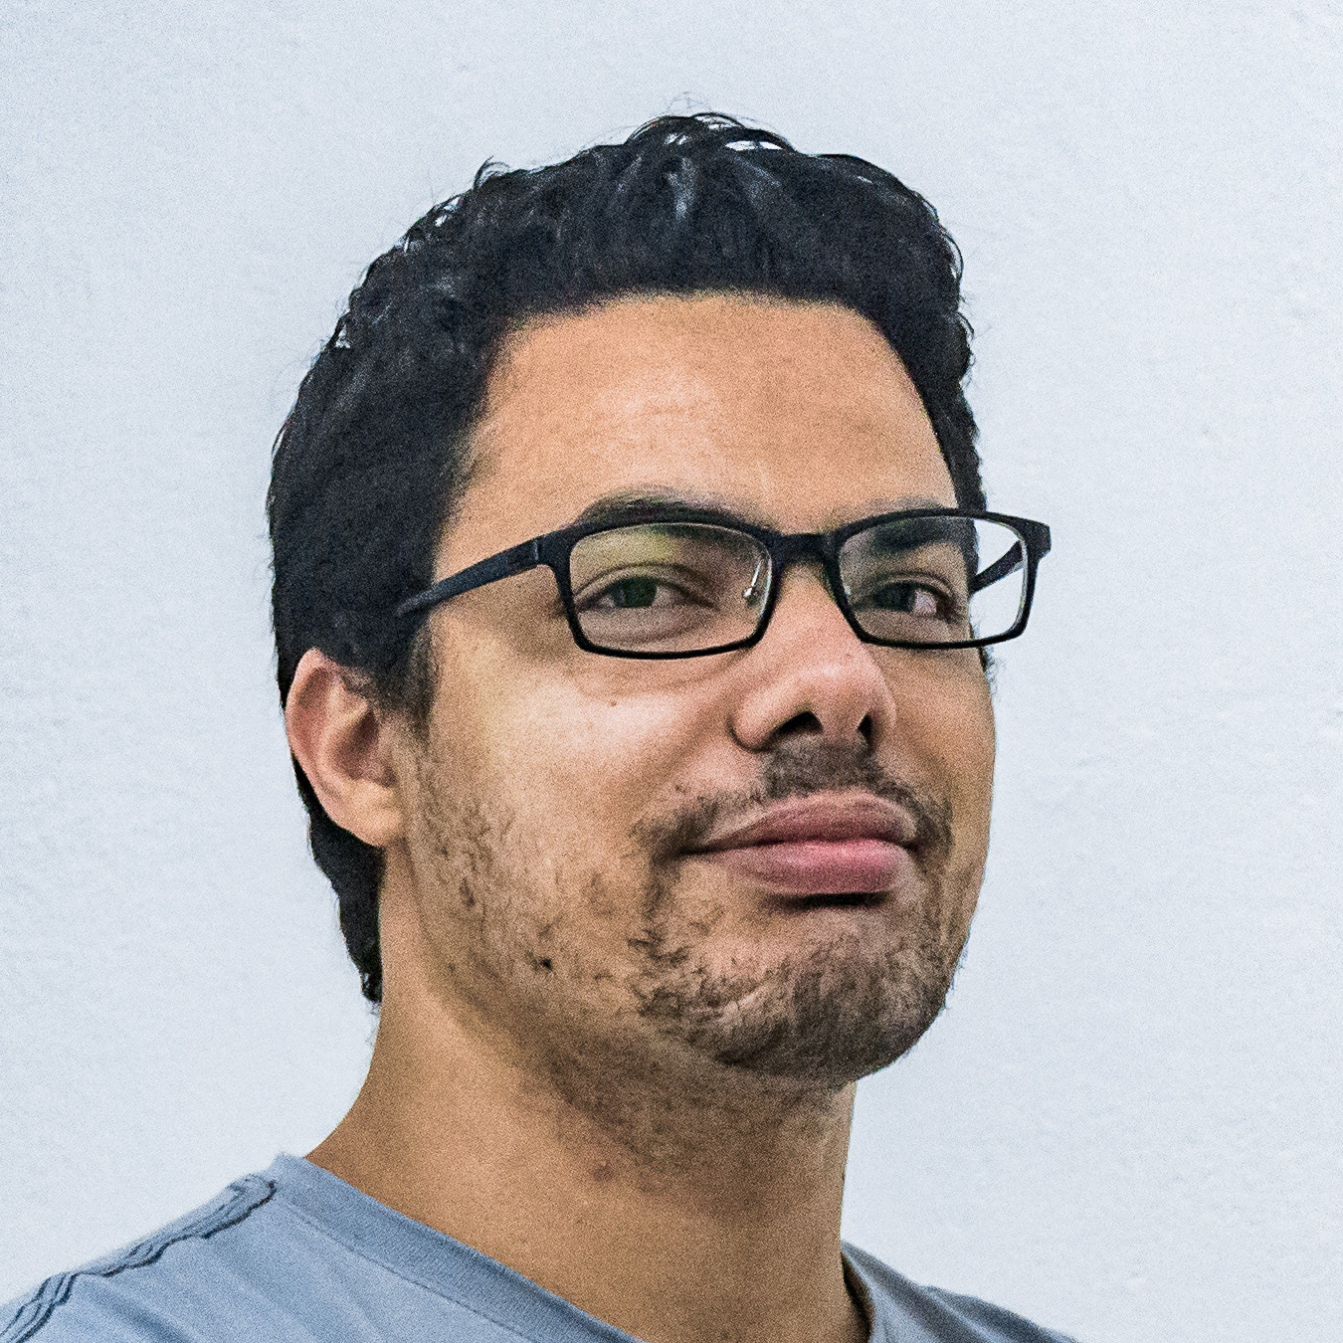


The Gong Product
?
?
?
CRM

Slide 6
Understanding Spoken Language
50-minute phone conversation

Slide 7
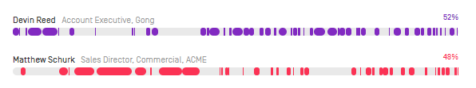
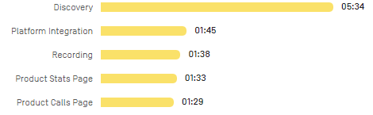
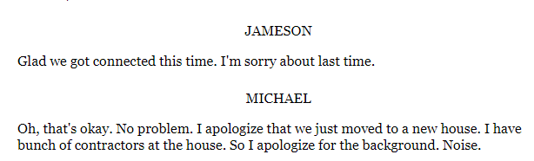
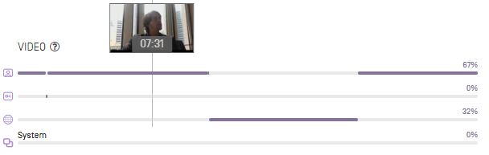
Understanding Spoken Language
50-minute phone conversation
How did the conversation progress?
Who spoke when?
What was discussed?
What was said?
What was shown?

Slide 8

Sample Business Insight

Slide 9
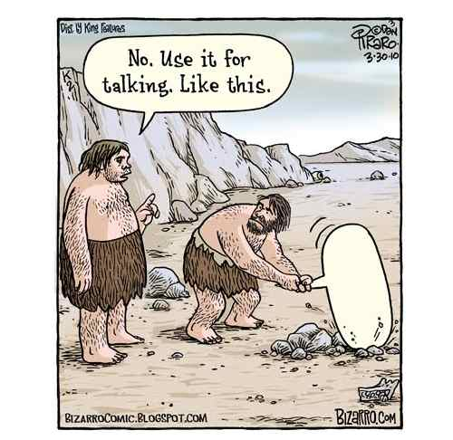

Slide 10
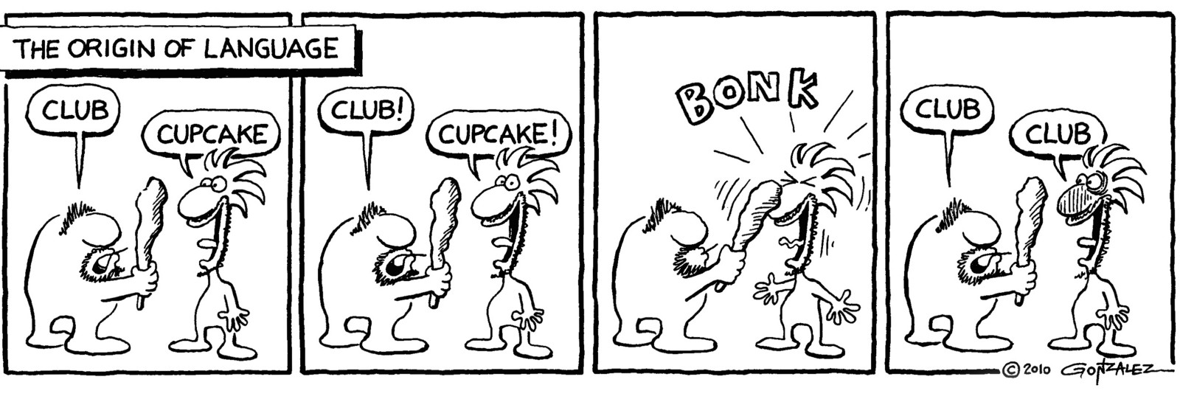

Slide 11
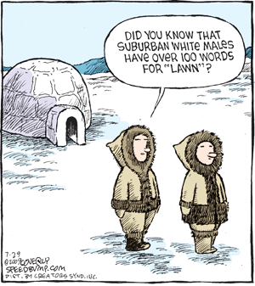

Slide 12
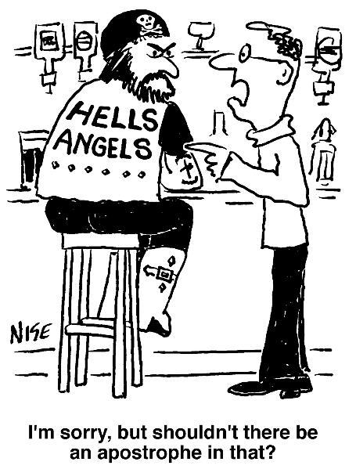

Slide 13


Slide 14
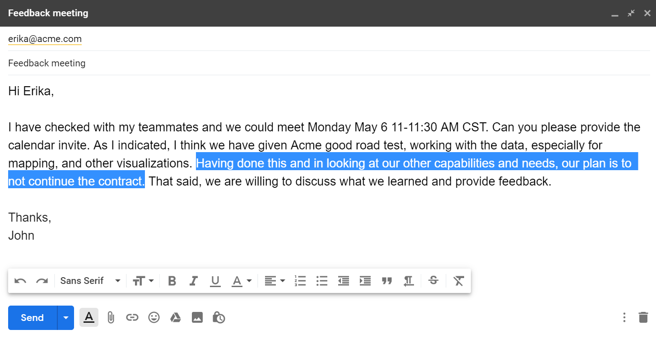
ML Example - Email Tagging

Slide 15
Emails -
Suggested Tags
Scheduling
Request for meeting (also includes "let's set up a demo", "let's set up a call")
Request for rescheduling
Nudge (reminder)
Introduction of a new person
Objections/concerns
Request for information about the product by the client
Product features information
Pricing request by the client
Pricing info by the seller
Proposal / commercial discussion
Request for client signature to close the deal
Technical issues

Slide 16
Today
We’ll start with the basics…
… and quickly move to State-of-the-Art models
We’ll have one lecture covering the material, followed by hands-on competition
We have a lot to cover – we’ll cover the most important parts

Slide 17
The Notebooks
Bag of Words and Tf-Idf
Word embeddings 2a. Optional: Train word embeddings 2b. Optional: Advanced sentence embedding methods in Flair
Contextual embeddings with ELMo 3a. Optional: Contextual word vectors with BERT and stacking embeddings
(Optional) Fine tuning a Language Model with ULMFiT
State-of-the-art Transformer with BERT

Slide 18
Our Dataset
Posts from 4 different newsgroups
rec.sport.baseball
rec.sport.hockey
talk.politics.guns
talk.politics.Mideast
Cut to length of 200-400 characters
Metadata was removed
This is a subset of a larger dataset of 20 newsgroups

Slide 19
ML Example - Email Tagging

Slide 20
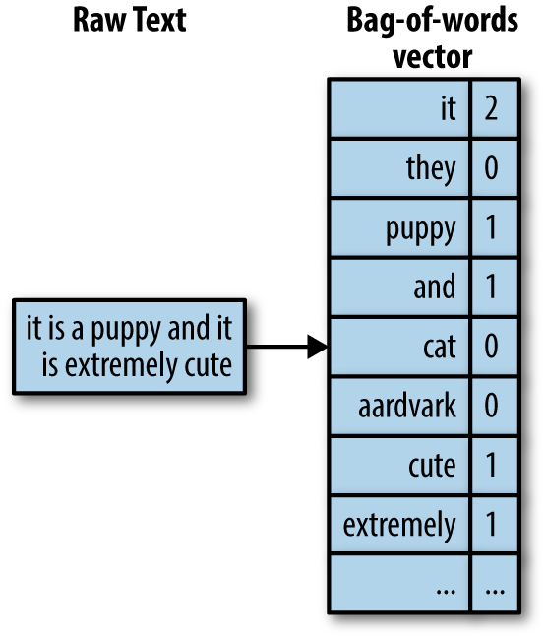
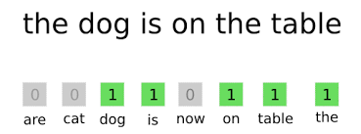
Text Classification – Bag of Words
Count the number of times each word appears in the text
Disregard word order
Represent the text as a vector of length V (size of the vocabulary)
Vocabulary size can be millions. We often use only the most common words (e.g. top 30,000 words)
Some words might be less informative (e.g. “a”, “the”) – they are called stopwords and are often removed (though be cautious, as they might be critical for some tasks!)
Use Logistic Regression, Naïve Bayes or any other ML algorithm to fit the data

Slide 21
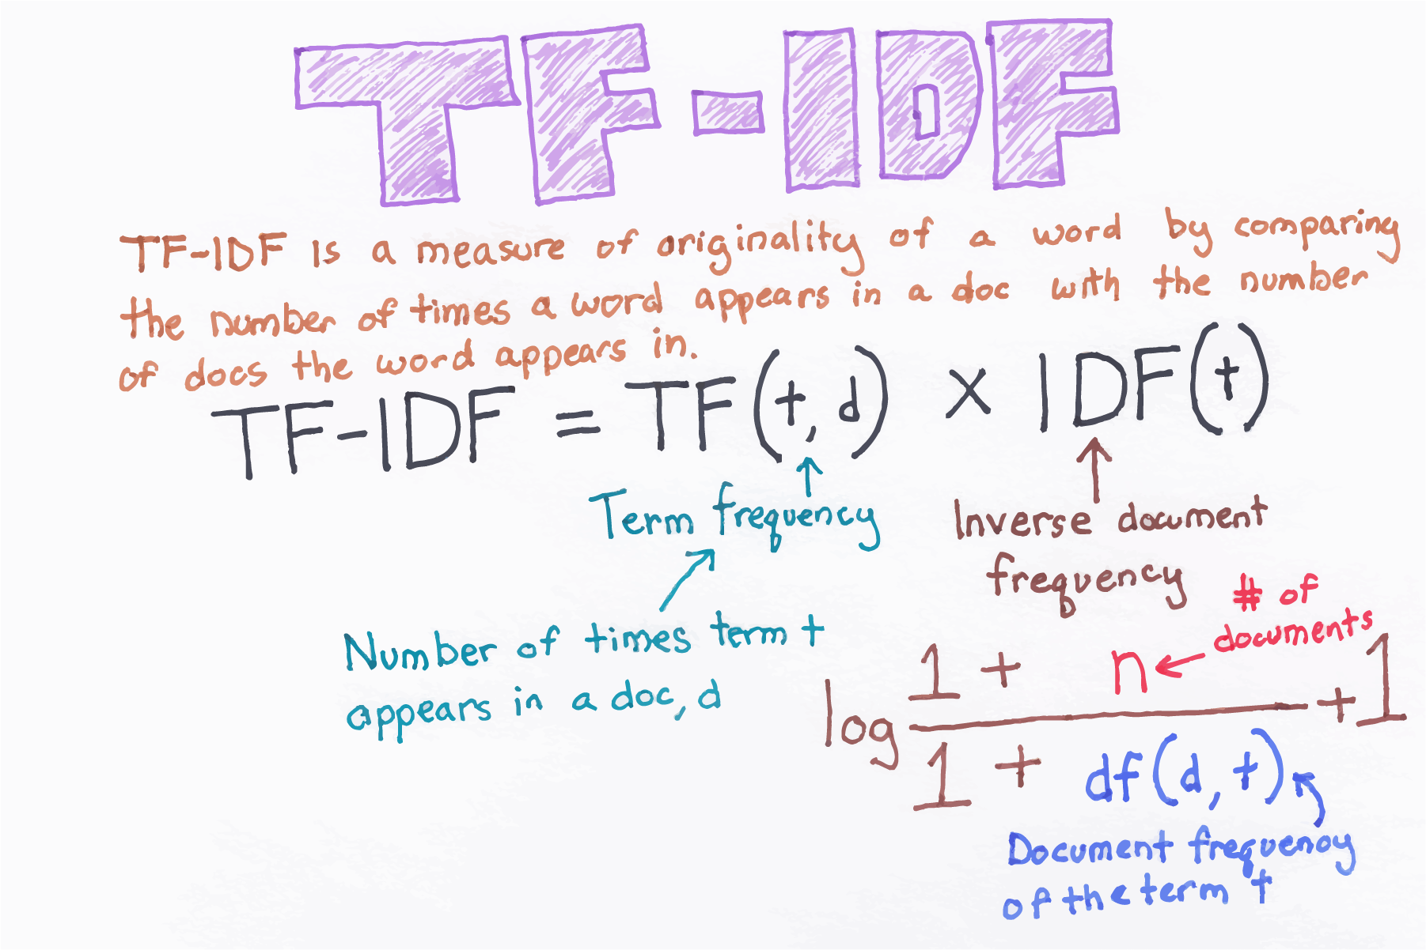

Slide 22
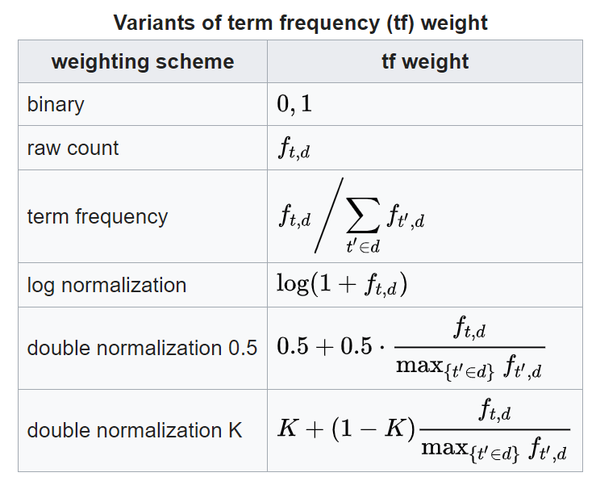
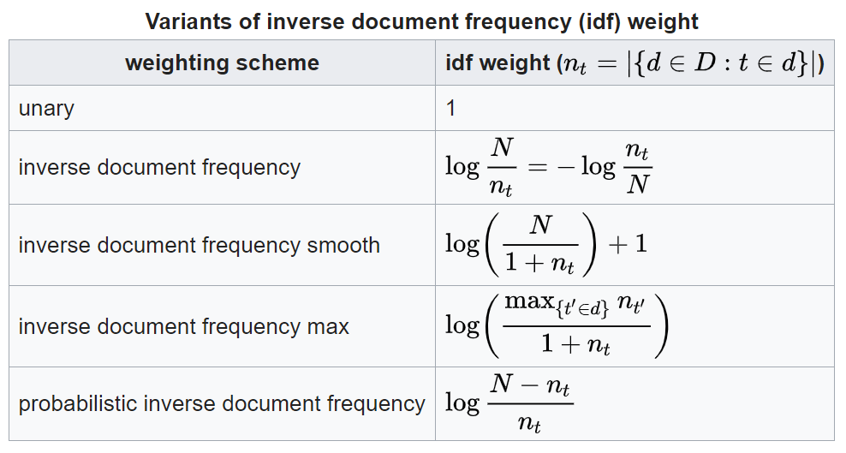
Common Tf-Idf Formulas

Slide 23
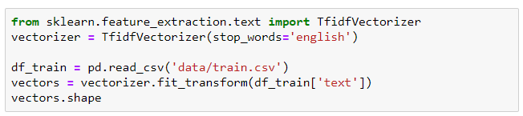
Code Sample
Code is in the notebook “bow_tfidf”
We’ll use sklearn. The Vectorizer conforms to the fit+transform API of sklearn
The notebook includes code for analyzing model performance

Slide 24
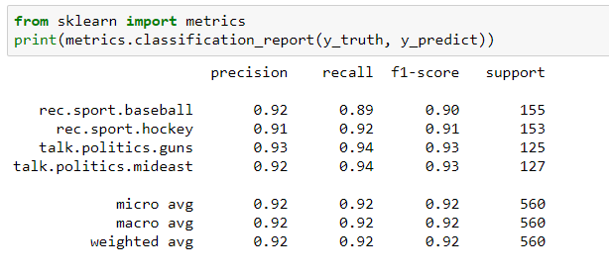
Classification Report

Slide 25
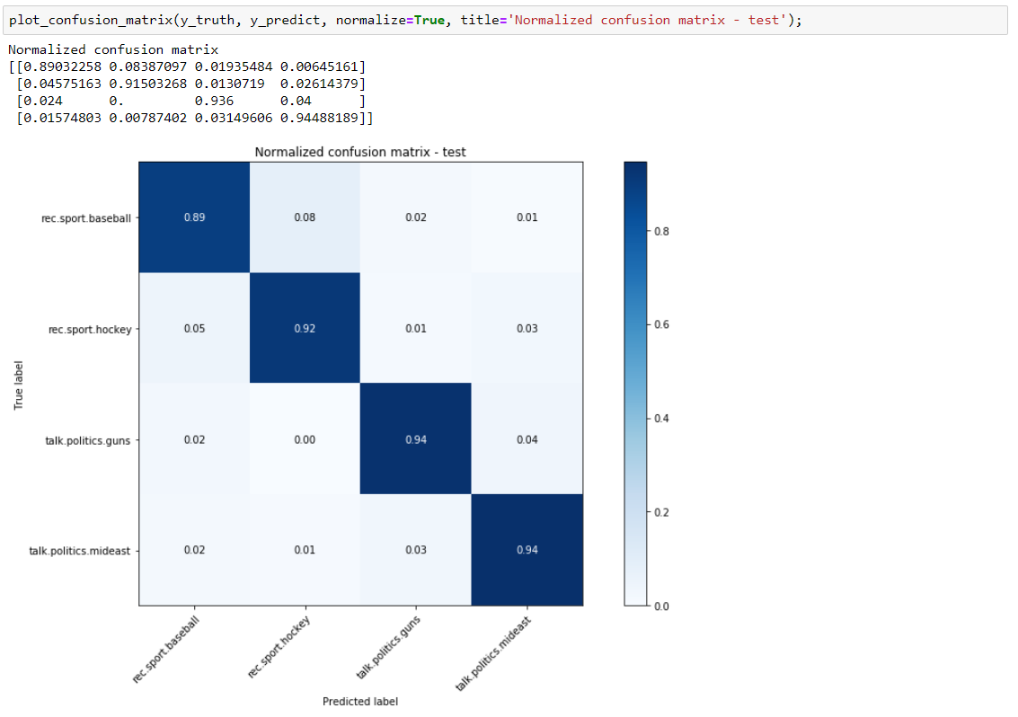
Confusion Matrix

Slide 26
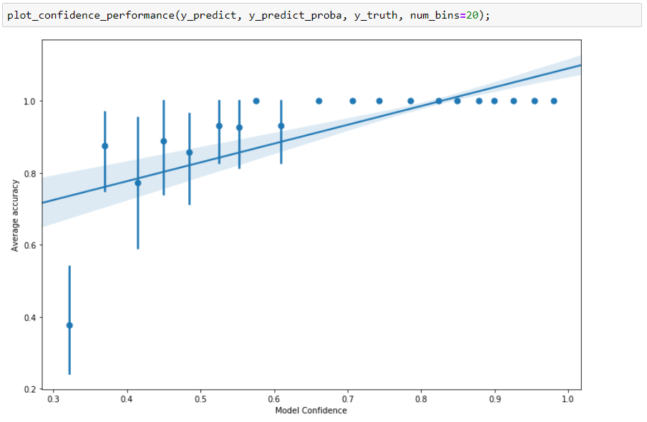
Confidence-Accuracy Graph

Slide 27
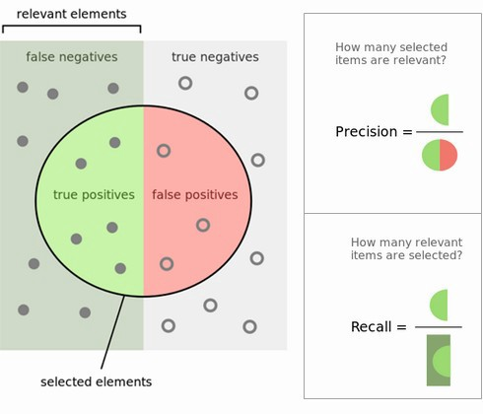

Slide 28
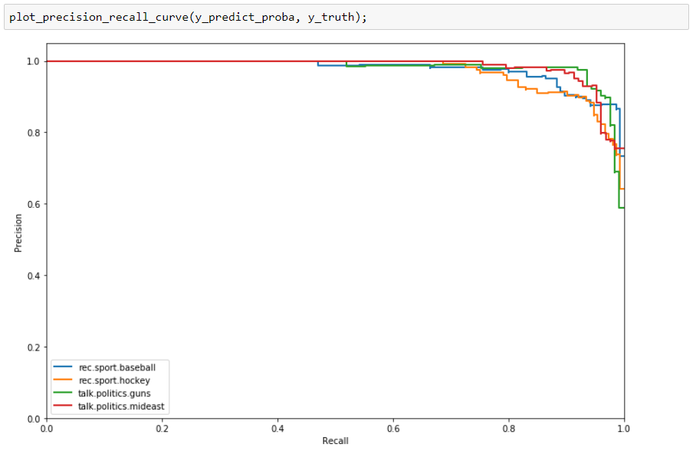
Precision-Recall Curve

Slide 29
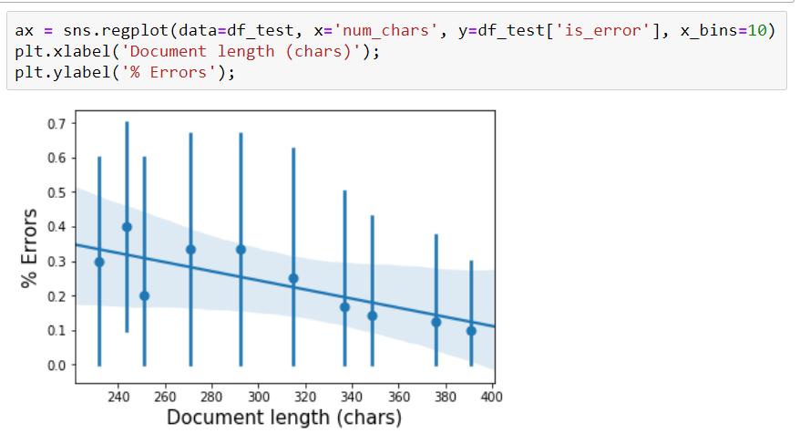
Error Analysis
It’s very useful to perform an error analysis for our basic model
Running on the entire dataset of all document lengths, we see that we mostly make errors for short documents

Slide 30
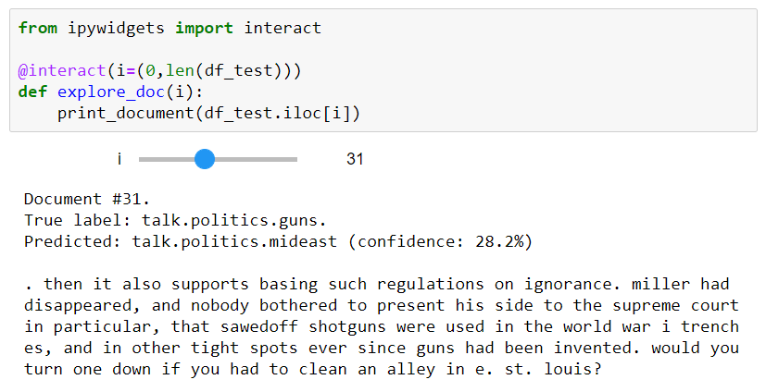
Reviewing Specific Documents

Slide 31
Bag of Words - Problems
We disregard the order of words
Words we haven’t seen before will be treated as a special token (UNK)
Very rare word (e.g. a word that only appears once in the training set) will also be treated as UNK
Cat ≠ Cats ≠ Kitten

Slide 32
Possible Solutions
 | Stemming | Lemmatization
going | go | go
gone | gone | go
goes | goe | go
went | went | go
Preprocess text
Lowercasing
Tokenization (I’ll -> I ‘ll)
Stemming / lemmatization
Use Smoothing

Slide 33
Possible Solutions
 | Stemming | Lemmatization
going | go | go
gone | gone | go
goes | goe | go
went | went | go
Use bigrams (2-grams), trigrams (3-grams) etc.
I will send it next week ->
“I will” , “will send” , “send it” , “it next” , “next week”
Problem: As we use larger n-grams (e.g. 5 or 6-grams), the chances of seeing a sequence get lower and lower
Solution: Use back-off techniques – compute probability of 6-grams from 5-gram and unigram

Slide 34
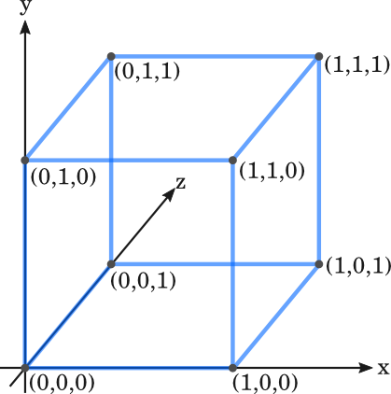
Bag of Words – One-Hot Encoding
One-Hot vectors
Problem:
We use one-hot encoding of words:
x_{cat}: [0 0 0 0 1 0 0 0 0 ]
x_{kitten}: [0 0 0 0 0 0 1 0 0 ]
x_{teapot}: [0 1 0 0 0 0 0 0 0 ]
and so treat words separately
||x_{cat} - x_{kitten}|| = ||x_{cat} - x_{teapot}||
Orange
Plane
Apple

Slide 35
One Hot Encoding - Alternatives
One-Hot vectors
Solution:
Lemmatization / Stemming
Use a dictionary of synonyms (e.g. WordNet)
Encode words as fixed-size vectors
Words with the same meaning can replace each other
What if we can map similar words to similar low-dimension vectors?
Orange
Plane
Apple
Wanted behavior
Plane
The Distributional Hypothesis (D.H.) (Harris, 1954):
“words are characterized by the company that they keep”
Words used in a similar context should have similar vectors
“She swoomped him with her frying pan” (G. Hinton)
Orange
Apple

Slide 36
Word Embeddings

Slide 37
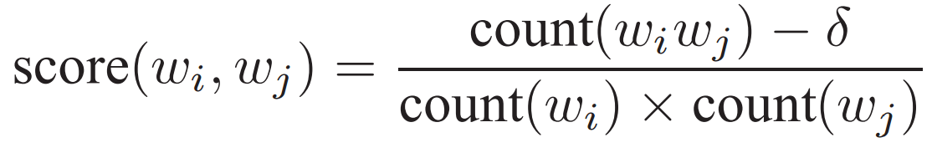
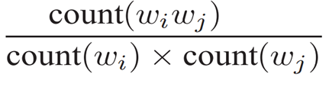
Co-occurrences
We wish to find words that appear frequently together, and infrequently in other contexts.
Think: What type of similarity does co-occurrence imply?

Slide 38
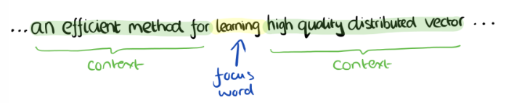
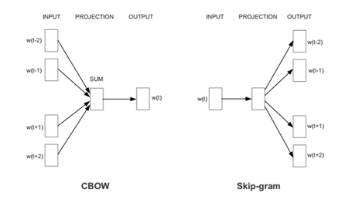
Distributed Word Representations
Continuous Bag–of–Words (CBOW):
As in N – Gram, predicts a word given its context (bidirectional).
Skip-gram:
Opposite from N – Gram, predicts the context given a word (bidirectional).
Mikolov at al., 2013

Slide 39
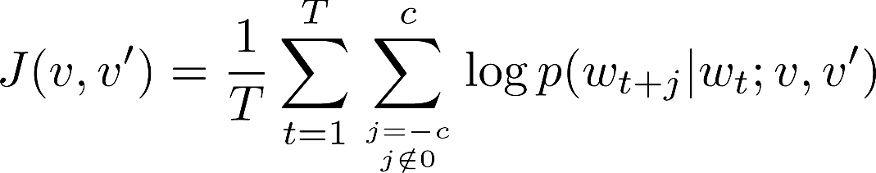
Skip-gram model
Overall objective (given a center word, predict surrounding ones):

Slide 40
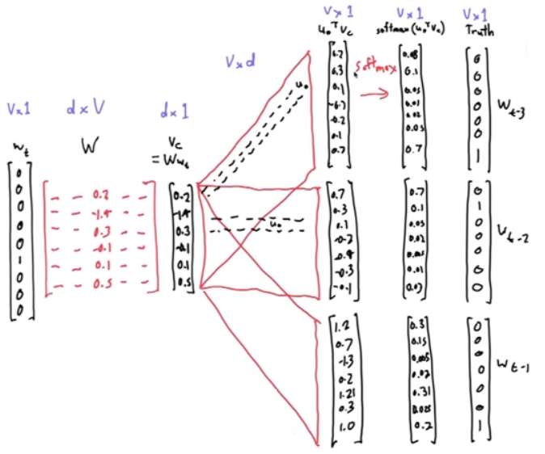
Skip–gram

Slide 41
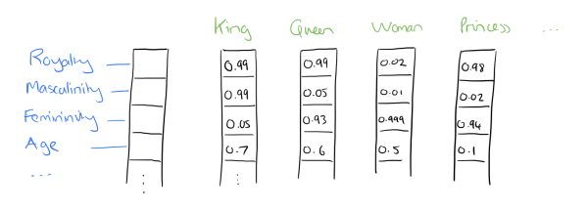
Benefits of Word Vectors
Much smaller in size than One-Hot encoding
Better similarity measures
Distributed representation. Might represent meaningful features like Part-of-Speech, singular/plural, gender etc.
Probably better generalization

Slide 42
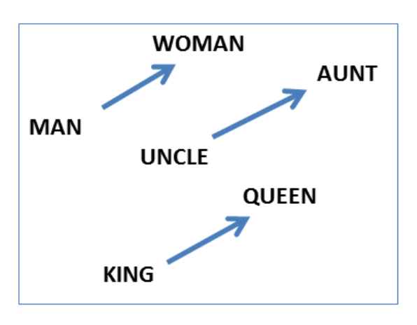
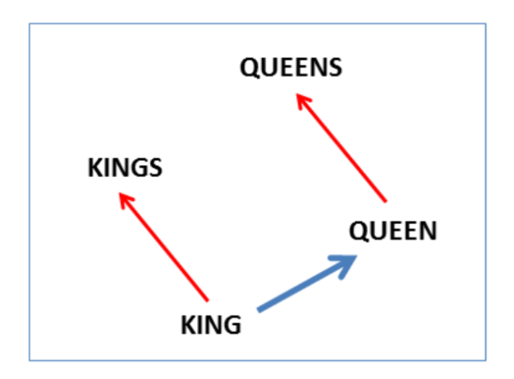
Word Vector Algebra

Slide 43

Word Vector Algebra
vector[Queen] = vector[King] - vector[Man] + vector[Woman]

Slide 44
Similar relations across languages
The dimensionality of the embeddings was reduced to 2 using PCA
The vectors were then rotated for maximal similarity
Mikolov et al. 2013
Notes:
Distributed word vector representations of numbers and animals in English (left) and Spanish (right). The five vectors in each language were projected down to two dimensions using PCA, and then manually rotated to accentuate their similarity. It can be seen that these concepts have similar geometric arrangements in both spaces, suggesting that it is possible to learn an accurate linear mapping from one space to another. This is the key idea behind our method of translation.

Slide 45
Cross-lingual
Train on 5K most frequent
Influence of word2vec training set
Mikolov et al. 2013
Notes:
5K most common were used for training
Examples of translations of out-of-dictionary words from Spanish to English. The three most likely translations are shown. The examples were chosen at random from words at ranks 5K–6K. The word representations were trained on the large corpora.

Slide 46
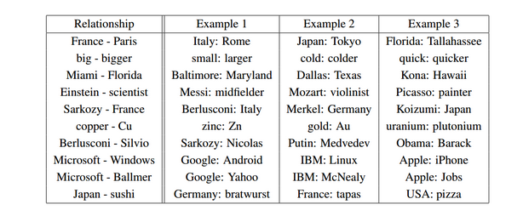
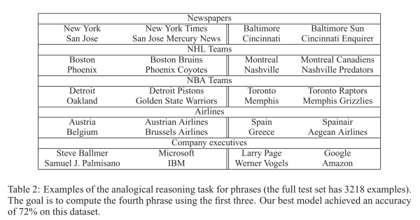

Slide 47
Differences between W2V and GloVe
W2V is a predictive model
It has a loss function it tries to minimize
GloVe is count based
It performs dimensionality reduction of the count matrix
As such, it tries to minimize a reconstruction loss
It’s easier to parallelize GloVe
If we wish to change the size of the embedding:
W2V: Rerun algorithm
GloVe: Factorize the co-occurrences matrix that was already computed
Original paper claims GloVe improves W2V performance by 11%
Levy & Goldberg claimed the comparison is unfair, and showed that GloVe provides a small improvement, if any

Slide 48
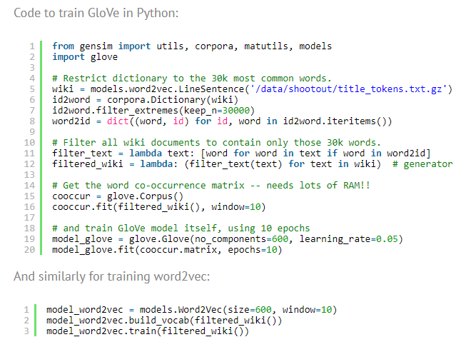

Slide 49
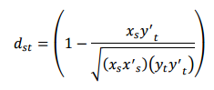
Reminder – Cosine Distance
Ignore the length of vectors, and only consider the angle between them

Slide 50
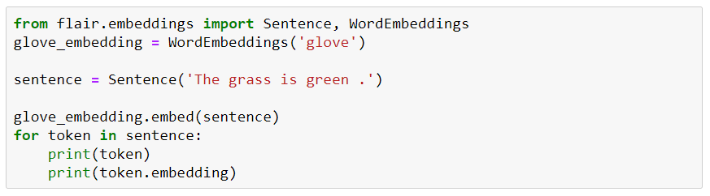
Code: Word Embeddings Using Flair
A full list of word embeddings available in Flair is here.

Slide 51
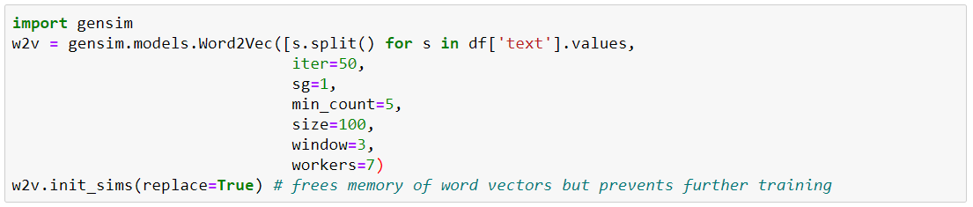
Code: Training Our Own Word Embeddings
The notebook “train_word_embeddings.ipynb” demonstrates training word vectors on our own corpus.

Slide 52
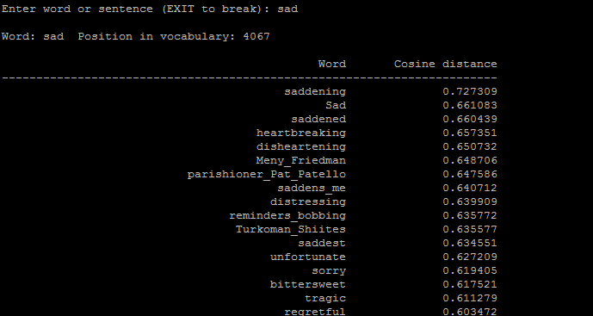
Applications of Word Vectors
Sentiment Analysis
Classic Methods: Naive Bayes, Random Forests/SVM
Classifying sentences as positive and negative
Building sentiment lexicons using seed sentiment sets
No need for classifiers, we can just use cosine distances to compare unseen reviews to known reviews.

Slide 53
Practical Advice
It’s simple to train your own vectors
e.g. using genism in python - https://radimrehurek.com/gensim/models/word2vec.html
Pretrained vectors are a good starting point in many cases, if your data isn’t very domain-specific
Can be frozen, or used as initial weights for a learned embedding matrix
It serves as a good tool to get to know your data
Which words are closest to a certain term?
Often very useful as a tool for exploration and guided search
E.g. “smart search” – suggest other search terms
Find competitors of a company
Cluster words
…

Slide 54
Practical Advice
Pre-processing can be very useful
Attenuate common words
Set a threshold for min words occurrences
Hyperparameters can determine what we learn
A small window vs. a large window
These algorithms don’t handle ambiguities well
“I went to the bank to deposit money”
“I went to the river bank”
Think: How can we handle this?
No real consideration of the prevalence of words

Slide 55
Practical Advice
Amount of Training Data
Should you train separately, or learn word embeddings as part of your supervised task?
How large should your vectors be?

Slide 56
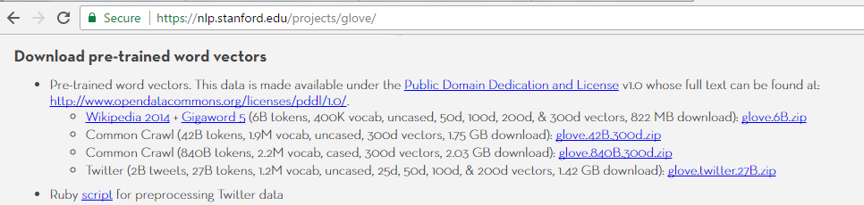
Fitting the problem domain
A word embedding model trained on a medical domain will be quite different for a model trained on a e-commerce domain.
One should build a dedicated vector representation usually by starting from a pre-trained general-purpose embedding model.

Slide 57
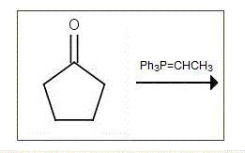



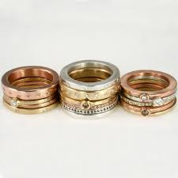
Comparison of Results Related words to “ring”
Wikipedia
Pinterest
Word
bell
tone
token
five-membered
cage
signet
wrestling
tag
wedding
inside
Word
engagement
wedding
promise
sterling
rings
knuckle
silver
band
stacking
pillow

Slide 58
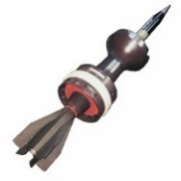
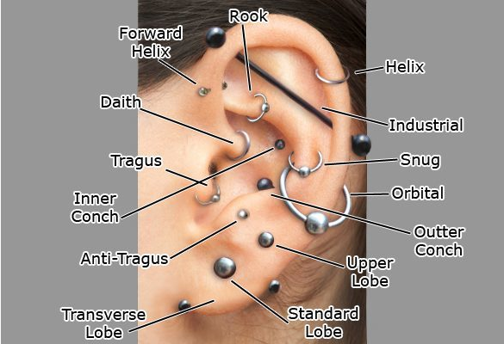
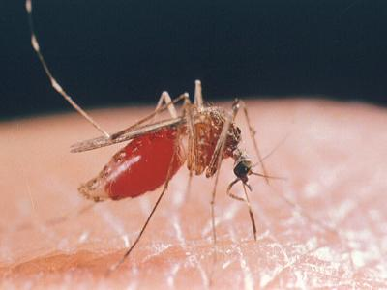
Comparison of Results - piercing
Wikipedia
Pinterest
Word
piercings
pierce
penetrating
sucking
pierced
armour
ear
armor
forehead
tattooing
Word
cartilage
helix
conch
tragus
16g
earring
navel
bellyring
lobe
barbell

Slide 59
Side Track – Vectors for Phrases
How can we get a vector for “New York City”?
Ideas:
Sum vectors of each word
Possibly weigh each word inversely according to its prevalence
Problem: The word “New” has different meaning in this context
Detect phrases, and learn “word” representations for them
As a preprocessing step, use PMI to find words that co-occur together
Replace them with a single token (e.g. “new_york_city”)

Slide 60
Sentence Embedding

Slide 61
Sentence Embedding
Generally problematic, as the same text can have different emphasis in different scenarios
A few baselines to consider:
Average word vectors
Average word vectors, inversely weighted by prevalence (so common words have less influence)
Learn a vector for each sentence during training (aka doc2vec, paragraph2vec)
Use the final hidden state of a RNNLM as an embedding of the entire document

Slide 62
Sentence Embedding Options
Average the word vectors of words in the sentence
Average the word vectors, weighted by their TfIdf
Cluster word vectors into a large number of clusters (e.g. using k-means), and classify the sentence based on the distribution of clusters
This is a form of dimensionality reduction
A similar approach is to use LDA to compute the topic of each word in a document, and classify the distribution of topics
In all of these, the word vectors can be learned using Word2vec / GloVe etc., or using a language model!

Slide 63
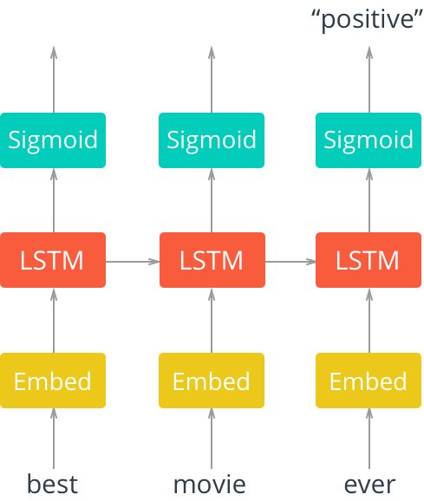
RNN for Text Classification
Embedding layer
Can be initialized randomly or using W2V etc
Can be frozen or trainable (preferred)
1+ layers of LSTM
Optionally, biLSTM
Softmax layer for output

Slide 64
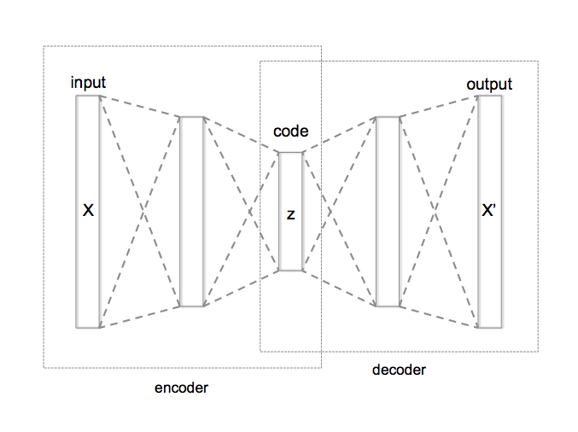
Sentence Embedding
Another idea - train a language model, and use the last hidden state as Sentence Embedding
Or, take a weighted average of several hidden states
Or, concatenate the hidden states into a single vector, and learn a classifier on top of it
We can also try an Autoencoder – try to predict the sentence itself from a bottleneck representation

Slide 65
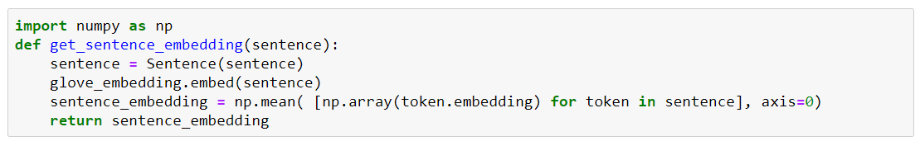
Sentence Embedding Using Flair & Numpy

Slide 66
Contextualized Word Embeddings with ELMo

Slide 67
Contextualized Word Representations
The meaning of a word is context-dependent; their embeddings should also take context into account
“The bank on the other end of the street was robbed”
“We had a picnic on the bank of the river”
Embeddings from Language Model (ELMo) uses language models to obtain embeddings for individual words while taking the entire sentence or paragraph into account

Slide 68
Contextualized Word Representations
Concretely, ELMos use a pre-trained, multi-layer, bi-directional, LSTM-based language model and extract the hidden state of each layer for the input sequence of words
ELMo improves the performance of models across a wide range of tasks, spanning from question answering and sentiment analysis to named entity recognition
Notes:
Then, they compute a weighted sum of those hidden states to obtain an embedding for each word
The weight of each hidden state is task-dependent and is learned

Slide 69
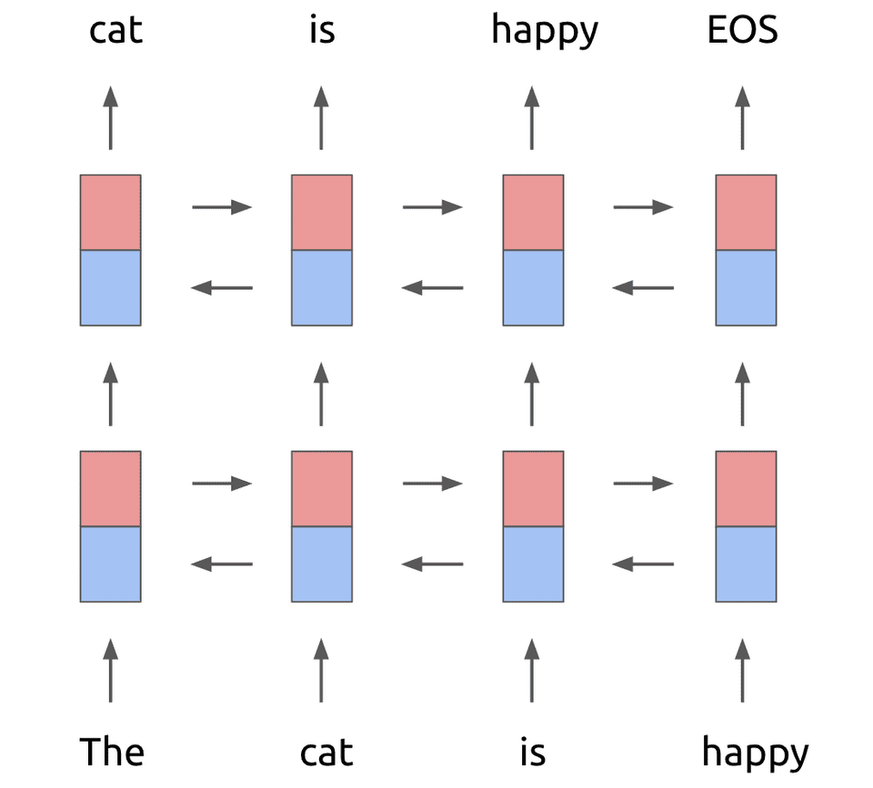
ELMo
Train a Language Model on a large corpus (1B Word Benchmark)
Train using a 2-layer LSTM
Use Character-level embedding using a CNN + Max pooling as input embeddings

Slide 70


Slide 71

ELMo embeddings are comprised of multiple layers

Slide 72

ELMo embeddings are comprised of multiple layers

Slide 73


Slide 74

Concatenating ELMo vectors
Adding ELMo vectors leads to SOTA performance

Slide 75

ELMo – Recommended Use
Concatenate ELMos with context-independent word embeddings instead of replacing them
Optionally, concatenate ELMos with the output as well

Slide 76
ELMo Model Details
2 bLSTM with 4096 units and 512 dimensions projections
Residual connections
Trained a 2048 channel char-ngram CNN followed by two highway layers and a linear projection down to 512 dimensions.
Layer normalization
Dropout + L2 weight decay

Slide 77
Transfer Learning

Slide 78


Slide 79


Slide 80


Slide 81


Slide 82
More specific
FC-1000
FC-4096
FC-4096
 | very similar dataset | very different dataset
very little data | Use Linear Classifier on top layer | You’re in trouble… Try linear classifier from different stages
quite a lot of data | Finetune a few layers | Finetune a larger number of layers
MaxPool
Conv-512
Conv-512
MaxPool
Conv-512
Conv-512
MaxPool
Conv-256
Conv-256
More generic
MaxPool
Conv-128
Conv-128
MaxPool
Conv-64
Conv-64
Image
Fei-Fei Li & Justin Johnson & Serena Yeung Lecture 7 - April 25, 2017

Slide 83
ULMFiT - Universal Language Model Fine-tuning

Slide 84
Transfer Learning using a Language Model
Use a Language Model to gain information about the language, learning both:
Low-level features (word representations)
High-level features (semantic meaning)
This is a form of Self-Supervised Learning
Fine-tune the model to the specific task
Faster
Achieves better performance with little data
Achieves better performance even with lots of data

Slide 85

Transfer Learning using ULMFiT

Slide 86

ULMFiT: LM Fine-tuning
LM fine-tuning can use only labeled data, or all task data

Slide 87
ULMFiT (Universal Language Model Fine-tuning)
Language models are powerful, and capture many relevant facets of language:
long-term dependencies (Linzen et al., 2016)
hierarchical relations (Gulordava et al., 2018)
sentiment (Radford et al., 2017)
There are lots of data for LM training, in most domains. They largely differ in the idiosyncrasies of a domain
LM tend to overfit
We say there’s “Catastrophic forgetting” when one attempts transfer learning and ends up overfitting on the small set and not being able to generalize well
“The same 3-layer LSTM architecture, with the same hyperparameters and no additions other than tuned dropout hyperparameters outperforms highly engineered models and transfer learning approaches on several text classification tasks”

Slide 88
BERT - Bidirectional Encoder Representations from Transformers

Slide 89

Trained on masked words + “is next sentence” prediction
To learn relationships between sentences, predict whether Sentence B is actual sentence that proceeds Sentence A, or a random sentence

Slide 90


Slide 91


Slide 92

Model Architecture
Multi-headed self attention
Models context
Feed-forward layers
Computes non-linear hierarchical features
Layer norm and residuals
Makes training deep networks healthy
Positional embeddings
Allows model to learn relative positioning

Slide 93

“Attention is all you need”
Allow attending to multiple words in the sentence
Similar to the way humans read text

Slide 94


Slide 95

BERT vs. ELMo

Slide 96
Model Architecture
Multi-headed self attention
Models context
Feed-forward layers
Computes non-linear hierarchical features
Layer norm and residuals
Makes training deep networks healthy
Positional embeddings
Allows model to learn relative positioning

Slide 97

BERT GLUE Performance
BERT smashed SOTA by a large margin
Since then, it lost the lead to similar architectures, with more parameters, trained on larger corpuses

Slide 98


Slide 99

Fine-tuning BERT

Slide 100


Main BERT architectures

Slide 101

Which embedding should we use?

Slide 102

Which embedding should we use?

Slide 103
BERT - Bidirectional Encoder Representations from Transformers
“BERT is designed to pre-train deep bidirectional representations by jointly conditioning on both left and right context in all layers. As a result, the pre-trained BERT representations can be fine-tuned with just one additional output layer to create state-of-the-art models for a wide range of tasks, such as question answering and language inference, without substantial task-specific architecture modifications.”

Slide 104


Slide 105

Masked LM
15% of the words in each sequence are replaced with a [MASK] token
The model attempts to predict the original value of the masked words

Slide 106
BERT Practical Considerations
BERT handles OOV tokens rather well, with sub-words tokenization
BERT is a huge model and is very slow
GPU is required for fine-tuning
Inference is also very slow (~10 sentences/second)

Slide 107

Play Time!

Slide 108
Our Dataset
Posts from 4 different newsgroups
rec.sport.baseball
rec.sport.hockey
talk.politics.guns
talk.politics.Mideast
Cut to length of 200-400 characters
Metadata was removed
This is a subset of a larger dataset of 20 newsgroups

Slide 109
Can you be #1? - Ideas
Use ELMo/BERT to derive word/sentence embeddings
Use larger SOTA models – BERT, XLNet, RoBERTa…
Stack word embeddings from multiple models
<INSERT YOUR WINNING SOLUTION HERE>

Slide 110
Advanced Ideas
Use character-based methods for word/sentence embeddings
Ensemble the predictions of different models
Train your own language model
Use semi-supervised methods
<INSERT YOUR WINNING SOLUTION HERE>

Slide 111
Please note
Code in Jupyter Notebooks should give you a head-start
Recent models like BERT are computationally-heavy and require a GPU –
Google Colab provides free GPU – enable it in your notebook
We haven’t performed any hyper-parameters optimization
The notebooks contain additional content, aimed to help you exploring things on your own at home

Slide 113

The Slides Graveyard

Slide 114
Sequences and Recurrent Neural Networks (RNNs)

Slide 115





Examples of sequence data
“The quick brown fox jumped over the lazy dog.”
Speech recognition
Music generation
$$∅$$
Sentiment classification
“There is nothing to like in this movie.”
DNA sequence analysis
AGCCCCTGTGAGGAACTAG
AGCCCCTGTGAGGAACTAG
Machine translation
Voulez-vous chanter avec moi?
Do you want to sing with me?
Video activity recognition
Running
Name entity recognition
Yesterday, Harry Potter met Hermione Granger.
Yesterday, Harry Potter met Hermione Granger.

Slide 116
Sequence Modeling using a Neural Network
Main differences:
The length of sequences changes
We want to share the weights
h₀
h₁
h₂
h₃
…
h_{T}
f_{W}
f_{W}
f_{W}
x₁
x₂
x₃
W

Slide 117
y₁
y₂
y₃
y_{T}
h₂
h₃
…
h_{T}
h₀
f_{W}
h₁
f_{W}
f_{W}
x₁
x₂
x₃
W

Slide 118
y₁
y₂
y₃
y_{T}
L₁
L₂
L₃
L_{T}
h₂
h₃
…
h_{T}
h₀
f_{W}
h₁
f_{W}
f_{W}
x₁
x₂
x₃
W

Slide 119

L
h₀
W

Slide 120

Unrolling an RNN

Slide 121


RNN – Recurrent Neural Network
We can process a sequence of vectors x by applying a recurrence formula at every time step:
y
RNN
new state
old state input vector at some time step
some function with parameters W
x

Slide 122
Many to one
y
h₂
h₃
…
h_{T}
h₀
f_{W}
h₁
f_{W}
f_{W}
x₁
x₂
x₃
W

Slide 123
One to many
y₁
y₂
y₃
y_{T}
h₂
h₃
…
h_{T}
h₀
f_{W}
h₁
f_{W}
f_{W}
x
W

Slide 124

Example: Character-level Language Model
Vocabulary: [h,e,l,o]
Example training sequence: “hello”

Slide 125
Example: Character-level Language Model
Vocabulary: [h,e,l,o]
Example training sequence: “hello”

Slide 126

Types of Sequence Labels
Text Classification

Slide 127
Types of Sequence Labels
Language Model
Part-of-Speech Tags

Slide 128
Types of Sequence Labels
Machine Translation

Slide 129
Types of Sequence Labels
Image Captioning

Slide 130
Types of Sequence Labels
Image Captioning
Text Classification
Machine Translation
Language Model
Part-of-Speech Tags

Slide 131

Can you see the future?
Predictions for current observations might be influenced by future observation
E.g. “It’s just that, you know, I don’t like that”.
We can use bi-directional RNNs

Slide 132
The Problem with RNNs

Slide 133


Slide 134


Slide 135


Slide 136


Slide 137


Slide 138
Gradient clipping
At each time tick,
check if grad abs value is more than … 5?
If so, clip it
large positive is now 5,
large negative is now -5
How large is too large?
Reduce clipping threshold until explosions disappear

Slide 139


Slide 140

LSTM – Long Short Term Memory
4 gates:
Input
Output
Input modulation
Forget

Slide 141

LSTM – Long Short Term Memory

Slide 142

LSTM – Long Short Term Memory
An LSTM cell has its memory C_{t} running on the top line
If helpful, it can remain unchanged, thus preserving information through long sequences
In addition, we have a hidden vector h_{t}
Information can be added or removed from it, using gates
Gates use a sigmoid function
Value between 0 (closed) and 1 (open)

Slide 143

Forget Gate
If the cell memory is not useful, we can “forget” it
Uses multiplication, to decide how much of it to keep (attenuation)

Slide 144

Input Gate
Next we decide what new information we want to keep in the cell memory
is a candidate for the cell memory, and not the actual cell memory!

Slide 145

Update the Cell memory

Slide 146

Output Gate
Finally, we need to decide what we actually output, again using a special gate

Slide 147

LSTM States
o
f
i
g
[Pictures: E Lobacheva, D Vetrov ]

Slide 148

Variants – Add Peep Holes
Let the gates see the cell state

Slide 149

GRU – Gated Recurrent Unit
Combine the forget and input gate into a single Update gate
The cell state and hidden state are also combined
A simpler “LSTM” architecture – with less parameters to learn
Faster training
Ability to learn longer sequences
Less power

Slide 150
GRU
Update gate
Candidate hidden vector
Actual hidden vector

Slide 151
Generating Sequences with RNNs
Start with some hidden state and input
Compute the most probable output using the RNN
Feed the output to the network as input, and continue
Think: How do we know that the sequence has ended?
Think: During training, should you use the real output, or the network’s?
Think: Can we do better than this greedy method of selecting the most probable output each time?

Slide 152
Example: Character-level Language Model
Vocabulary: [h,e,l,o]
Example training sequence: “hello”

Slide 153



at first:
train more
train more
train more

Slide 154


Slide 155


Slide 156

Image Captioning Dataset

Slide 157


Slide 158
Can we take this further?
We know how to generate a caption for an image
In Object detection, we encode a region using a CNN and used it to detect objects in it
We can encode a region using CNN and create a label for it
We can use a Region Proposal Network
Can be used for image retrieval - "find me an image with a cat riding on a skateboard"

Slide 159

Describing images

Slide 160

Common NLP Tasks

